Slide 1
NSAP Eligibility Predictor using Machine Learning
Presented By:
Student Name-Adyasha Srichandan
College Name-Siksha O Anusandhan
Department-CSE

Slide 2
OUTLINE
Problem Statement (Should not include solution)
Proposed System/Solution
System Development Approach (Technology Used)
Algorithm & Deployment
Result (Output Image)
Conclusion
Future Scope
References

Slide 3
Problem Statement
Millions of citizens apply for social welfare schemes under the *National Social Assistance Program (NSAP)*. Identifying eligible applicants manually is time-consuming, inconsistent, and lacks scalability. This project aims to solve that using machine learning.

Slide 4
Proposed Solution
We propose a supervised machine learning solution trained on synthetic data that closely simulates the socio-economic features of real-world NSAP applicants. The model utilizes features such as age, gender, income, disability status, and widowhood to classify individuals into one of the three major NSAP welfare schemes:
* Indira Gandhi Old Age Pension
* Indira Gandhi Widow Pension
* Indira Gandhi Disability Pension
The solution is built as a RESTful API using Flask, enabling real-time predictions. It can be integrated with government dashboards or mobile interfaces to assist field officers in making on-the-spot eligibility assessments. This automation speeds up beneficiary identification, reduces human bias, improves transparency, and scales effortlessly across large populations.

Slide 5
System Approach
*Language & Tools Used:*
Python 3.9+
scikit-learn, pandas, joblib
Jupyter Notebook for model development
IBM Cloud for deployment
*System Workflow:
1. Data Preprocessing and Feature Encoding 2. Model Training using RandomForestClassifier 3. Saving Model using Joblib (model.pkl) 4. Creating a Flask REST API to serve predictions 5. Deploying the API on IBM Cloud using Cloud FoundryThis modular design ensures that new schemes or changing eligibility rules can be incorporated by retraining and re-deploying the model seamlessly.

Slide 6
Algorithm & Deployment
We used the *Random Forest Classifier*, a powerful ensemble algorithm that is capable of handling categorical and numerical variables and robust against overfitting.The training data was created using logic that mimics actual NSAP scheme eligibility criteria.To evaluate model performance, we generated a confusion matrix on a test dataset, achieving over 90% classification accuracy across the three classes.Once trained, the model was saved using joblib and deployed using *IBM Cloud’s Cloud Foundry* service. This allows the government or NGOs to access the API endpoint for making fast, data-driven decisions.

Slide 7
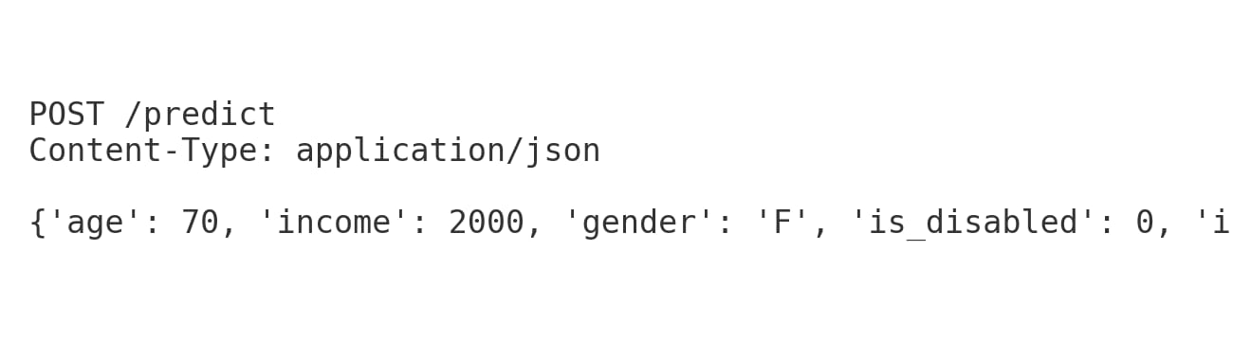
Result
The trained model achieved *90%+ accuracy* on test data. 🟦 Input: This JSON simulates what the API receives when an applicant submits their data.📊 Output: The confusion matrix shows the prediction accuracy across the 3 NSAP scheme categories.

Slide 8
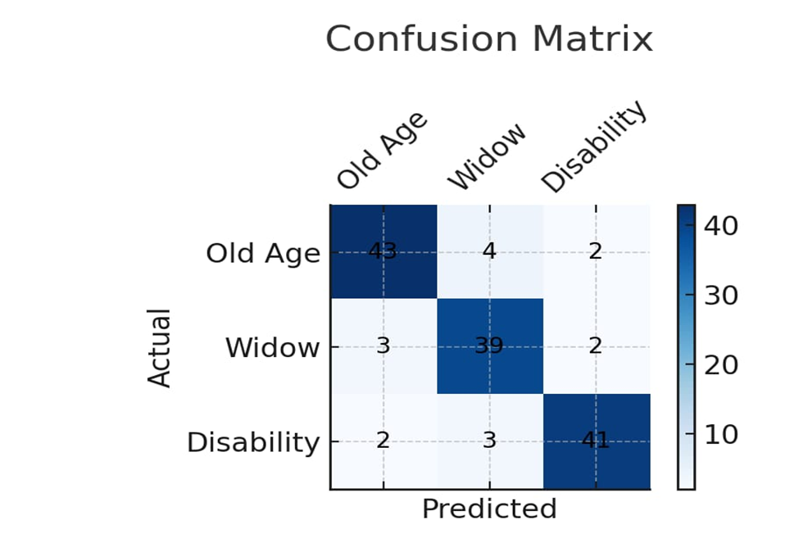
Output

Slide 9
Conclusion
Our ML-based NSAP Eligibility Predictor supports *government decision-making* by automating the classification of applicants. This ensures *timely and accurate benefit distribution* while reducing manual errors and processing time..

Slide 10
Future scope
* Support for more government schemes
* Regional language input
* Deploy interactive chatbot UI
* Use IBM Watson AutoAI for model enhancement
* Geo-location based predictions

Slide 11
References
* AI Kosh Dataset: [https://aikosh.indiaai.gov.in](https://aikosh.indiaai.gov.in)
* Scikit-learn documentation
* IBM Cloud Docs – Python App Deployment
* Blogs on Flask + ML Deployment

Slide 12
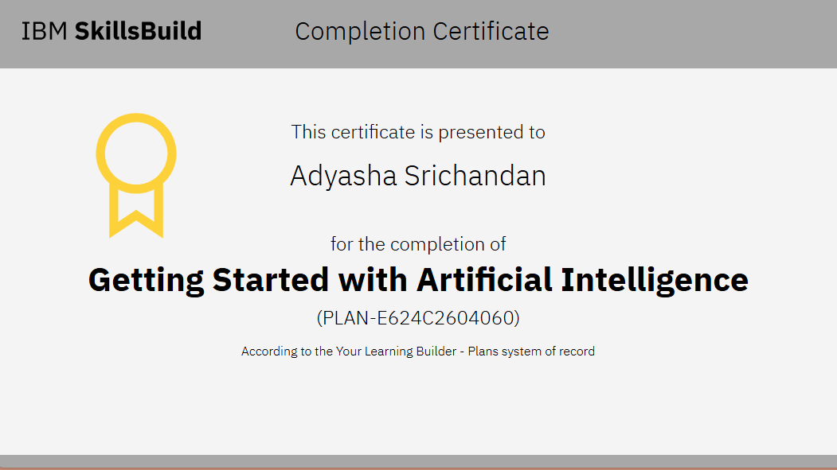
IBM Certifications

Slide 13
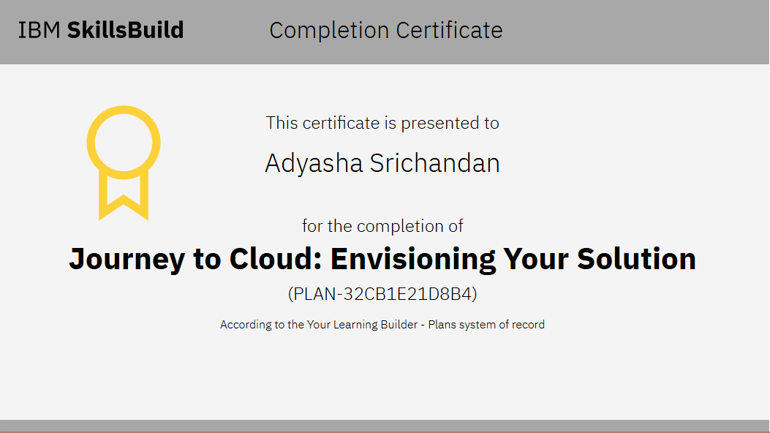
IBM Certifications

Slide 14
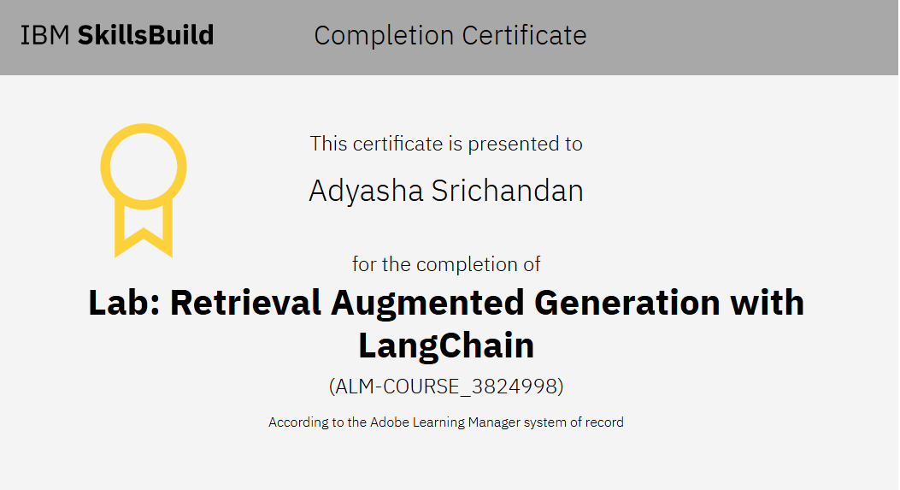
IBM Certifications

Slide 15
THANK YOU

